Slide 1

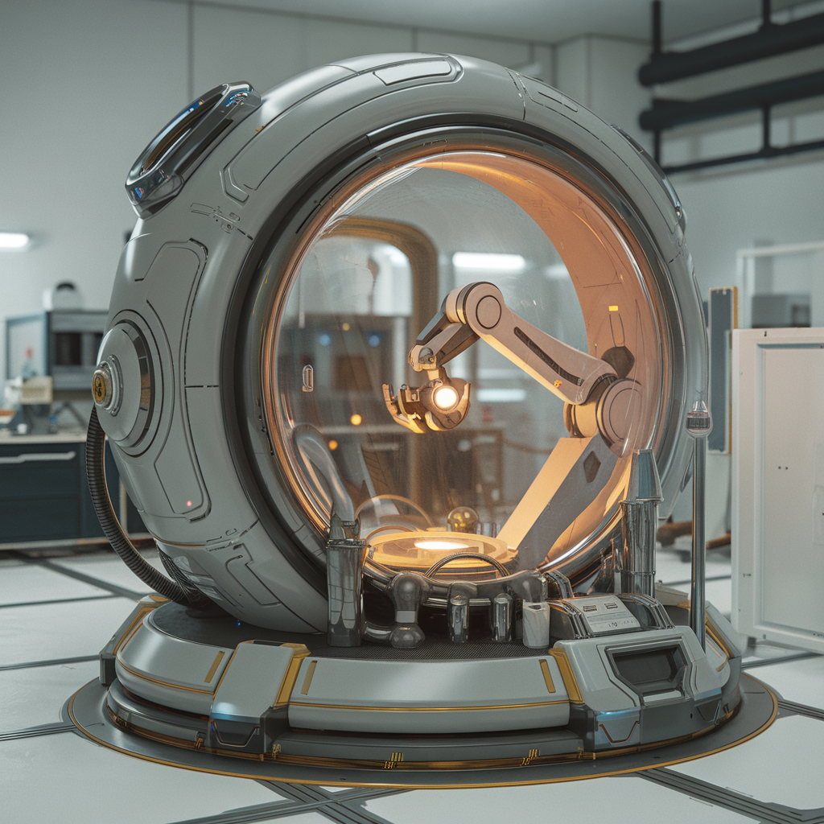
Technologies
INVESTIGATING SCIENCE MODULE 6:

Slide 2
6.1
6.1: How does technology enhance and/or limit scientific investigation?
6.1.1: design a practical investigation that uses available technologies to measure both the independent and dependent variables that produce quantitative data to measure the effect of changes of, including but not limited to:
temperature on reaction rate
temperature on volume of gas
speed on distance travelled
pressure on volume of gas
6.1.2: conduct the practical investigation to obtain relevant data and evaluate the limitations of the technologies used
6.1.3: investigate the range of measuring devices used in the practical investigation and assess the likelihood of random and systematic errors and the devices' degree of accuracy using specific examples, compare the accuracy of analogue and digital technologies in making observations
6.1.4: assess the safety of technologies selected for the practical investigation by using chemical safety data and Work Health and Safety guidelines as appropriate

Slide 3
6.1.1
Design a practical investigation that uses available technologies to measure both the independent and dependent variables that produce quantitative data to measure the effect of changes of, including but not limited to:
temperature on reaction rate
temperature on volume of gas
speed on distance travelled
pressure on volume of gas

Slide 4
6.1.1
temperature on reaction rate
temperature on volume of gas
speed on distance travelled
pressure on volume of gas
For each, state the:
Independent variable
Dependent variable
Then describe a method you think you might be able to develop to investigate each one. Remember: dot/numbered points for methods.

Slide 5
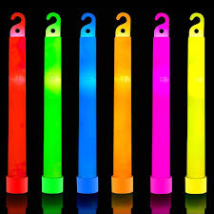
Potential Experiments: Temperature on Reaction Rate
Alka Seltzer dissolution (Citric acid + sodium bicarbonate ➔ sodium citrate + water + CO₂)
Glow stick light production
Catalase enzyme – oxygen production

Slide 6

Potential Experiments: Temperature on Volume of Gas
Balloon volume in (hot, cold) water
Syringe in hot/cold water

Slide 7
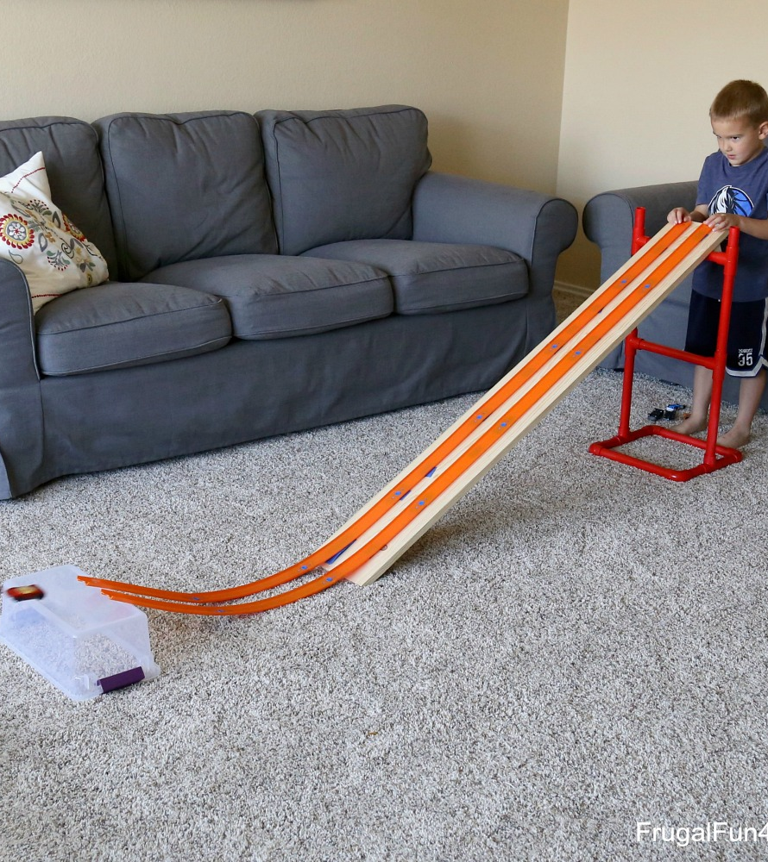
Potential Experiments: Speed on Distance Travelled
Ball, toy car, etc down a ramp (here, we will need to measure both speed and distance and graph them both: scatterplot).

Slide 8
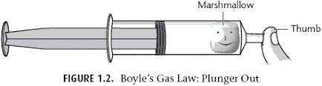
Potential Experiments: Pressure on Volume of Gas
Mini marshmallow and syringe

Slide 9
6.1.2
Conduct the practical investigation/s to obtain relevant data and evaluate the limitations of the technologies used
Evaluate: pros, cons, judgement.

Slide 10
Evaluation of Experiments
Temperature on reaction rate (~Arrhenius Equation/Theory)
Temperature on volume of gas (Charles’ Law)
Speed on distance travelled
Pressure on volume of gas (Boyle’s Law)

Slide 11
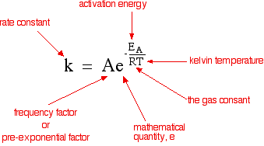
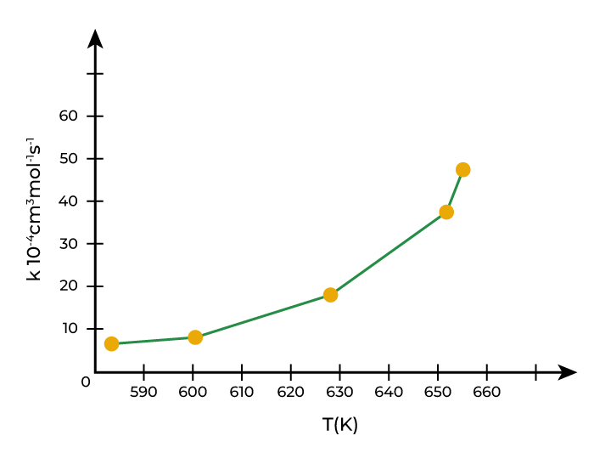
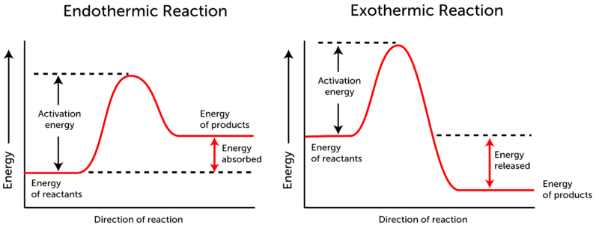
Temperature & reaction rate
Arrhenius created an equation to show that as temperature increases, so too does reaction rate.
This links to a lot of our knowledge about chemical reactions, including those that are exothermic (heat-releasing) and endothermic (heat-absorbing).

Slide 12
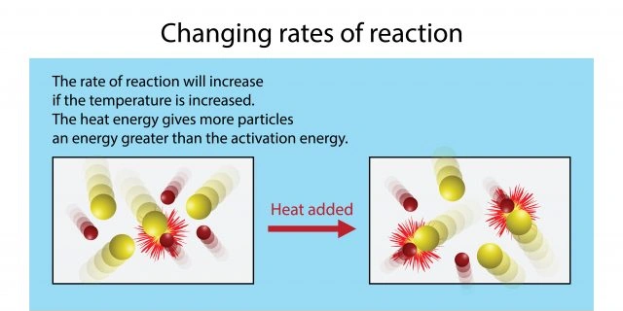
Temperature & reaction rate
Simply put, a higher temperature means particles are moving faster, with more energy.
This enables colliding particles to not just bounce off each other, but to combine or break apart and form new substances.

Slide 13
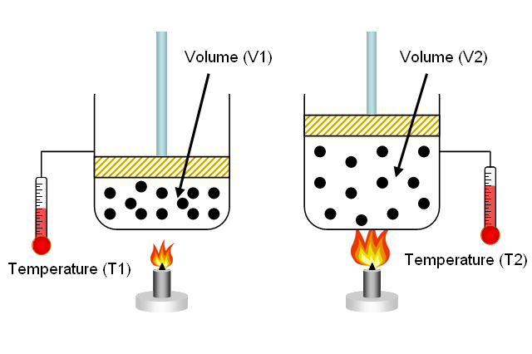
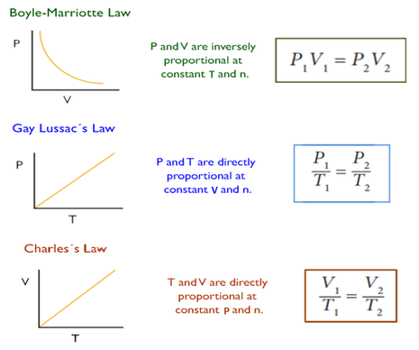
Temperature & volume of gas
Charles’ Law states:
When the pressure on a sample of a dry gas is held constant, the temperature and the volume will be in direct proportion.
From this, it is also known if temperature increases, so too does volume. Likewise, if temperature decrease, so too does volume.
That is, temperature and volume of gases are linked.

Slide 14
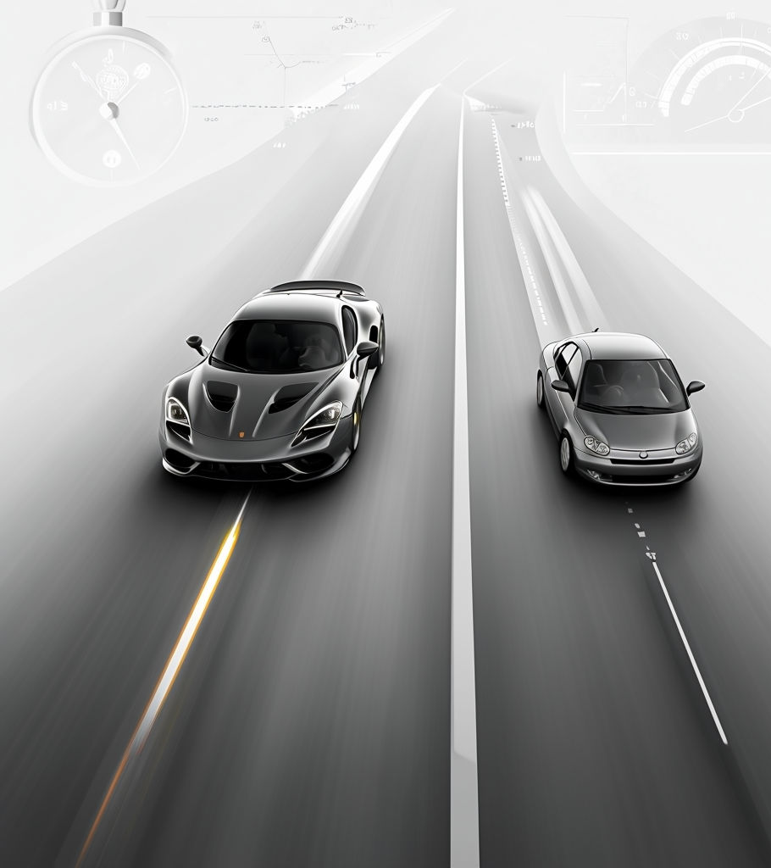
Speed & distance travelled
Although not a named law, it can be shown again and again that as speed (velocity) increases, so too does distance travelled.
However, this is simply a by-product of the units of velocity and pretty much common sense:
Velocity has the SI units of metres per second (m.s⁻¹). It stands to reason that if an object has a higher velocity, then it will travel a greater distance in the same amount of time.

Slide 15
Pressure & volume of gas
Boyle’s Law states:
The absolute pressure exerted by a given mass of an ideal gas is inversely proportional to the volume it occupies if the temperature and amount of gas remain unchanged within a closed system.
In other words, if pressure increases, volume decreases. Likewise, if pressure decreases, volume increases. Pressure and volume are inversely linked.

Slide 16
6.1.3
Investigate the range of measuring devices used in the practical investigation and assess the likelihood of random and systematic errors and the devices' degree of accuracy using specific examples, compare the accuracy of analogue and digital technologies in making observations

Slide 17
Experimental Errors
Error is the difference between a measured quantity and its true value. Errors relate to accuracy. The smaller the error, the more accurate the data.
Errors in experimental measurements are often placed into two main categories: random and systematic.
We use these categories to help us understand how to minimise errors in the future.

Slide 18
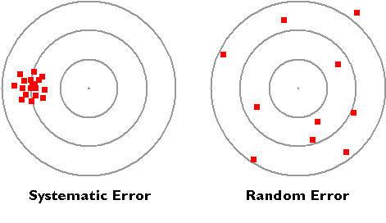
Random Errors
Random errors are caused by changes in conditions that result in values both higher and lower than the true value.
A common analogy is an archery range (Figure 1)
To reduce random error, we can repeat our measurements and calculate an average to improve accuracy. As a result, the average is more likely to be in the middle, which is the true value.
Figure 1: An analogy of random error using the results observed at an archery range – both sides of the true value.

Slide 19
Random Errors - Examples
Examples of random error:
Measuring your blood pressure
Reading volume in a measuring cylinder from different angles each time
Assessing test subject memory at different times of day
Measuring length with a tape with 1 cm markings
Figure 1: An analogy of random error using the results observed at an archery range – both sides of the true value.

Slide 20
Systematic Errors
Systematic errors are directional changes in measurements that are one side of the true value: higher/lower.
A common analogy is seen in Figure 2.
Systematic error is often caused by an instrumental fault, consistent user error, or environmental conditions.
Figure 2: An analogy of systematic error using the results observed at an archery range – often clustered to one side of the true value.

Slide 21
Systematic Errors - Examples
Examples of systematic error:
Using a scale that has not been tared/zeroed beforehand
Asking leading questions in a survey
Reading the speed of your car from the passenger side
Only choosing experiment participants from a specific group/population
Figure 2: An analogy of systematic error using the results observed at an archery range – often clustered to one side of the true value.

Slide 22
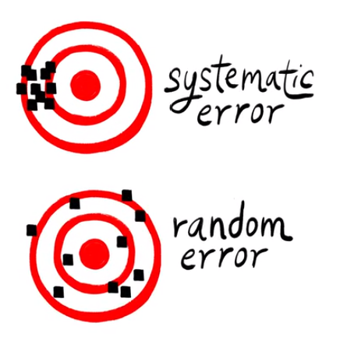
Error Analogy

Slide 23
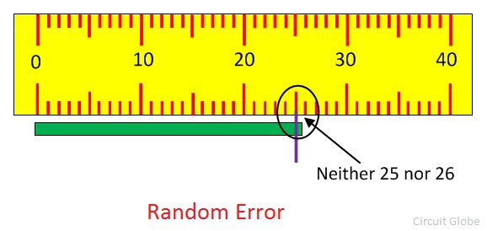
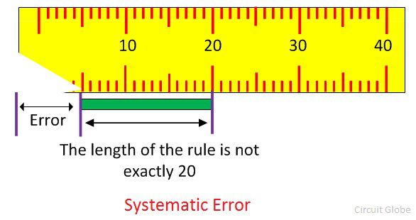
Error Type Comparison

Slide 24
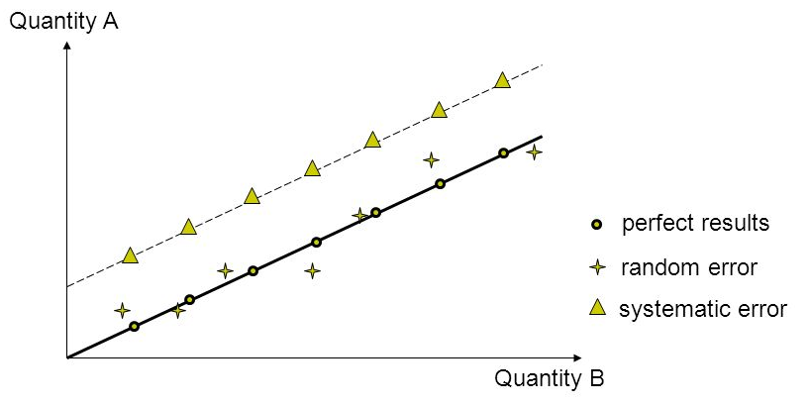
Error Type Comparison – Graphed

Slide 25
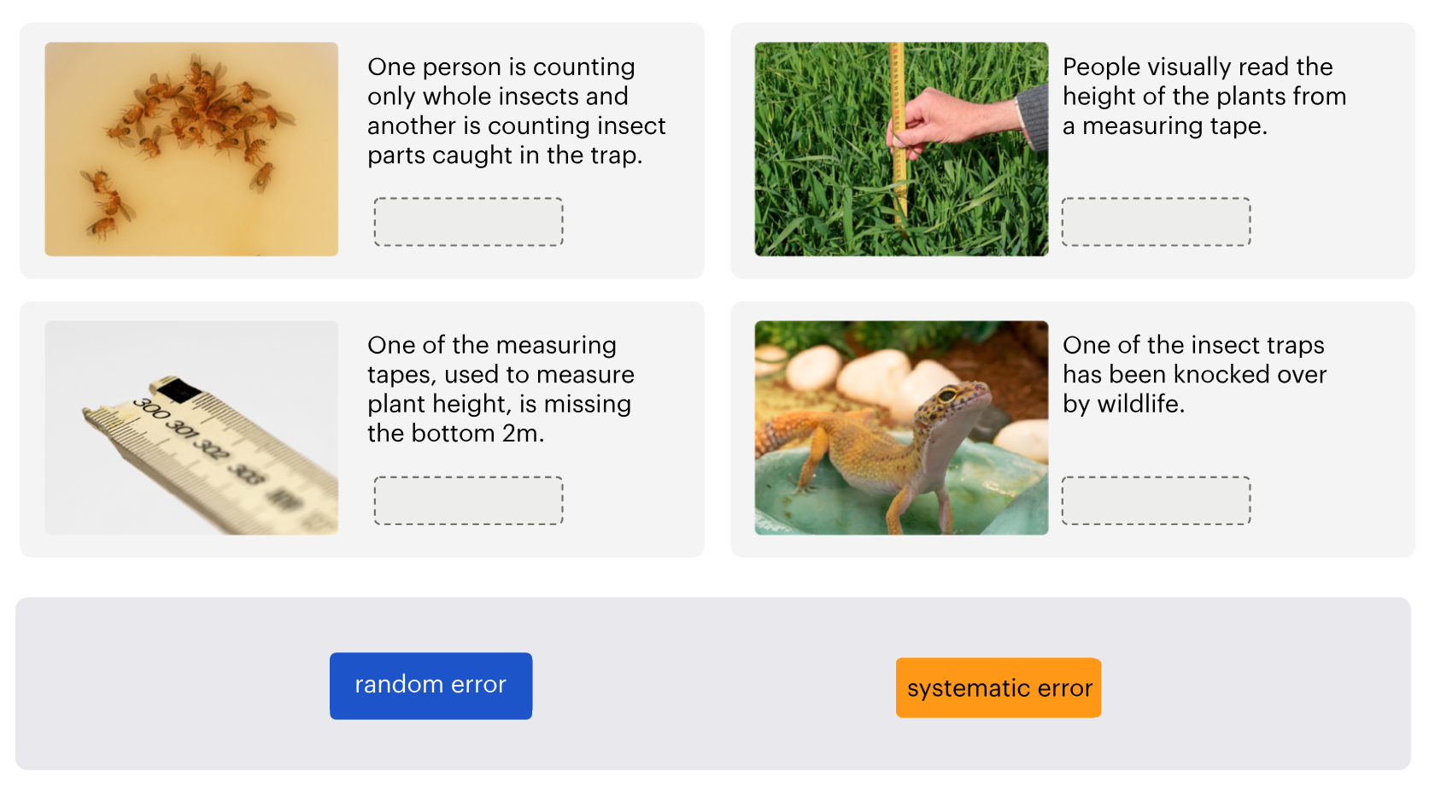
Random or Systematic Error?
Research question: Does plant height affect insect abundance?
Hypothesis: If the plant height increases, the insect abundance increases.
Fieldwork summary: A group of students went out on two separate days. A total of 40 plant heights were measured on each day.
Students used bowls of soapy water to trap insects at the site of each plant. A total of eight replicate insect traps were used per plant. The average number of insects trapped at each plant site is included in the data set.

Slide 26
Accuracy & Precision
In Science, we talk often about accuracy, reliability and validity.
However, some often confuse or interchange the terms accuracy and precision. Know they are not the same.

Slide 27

Accuracy vs. Precision
Accuracy
Closeness of the measured value to the true value
Relates to the overall error (random + systematic errors)
The smaller the systematic error in an experiment or reading, the more accurate it is.
Precision
Extent to which repeated measurements agree with each other.
Internal reliability.
The smaller the random error, the more precise the experiment.

Slide 28
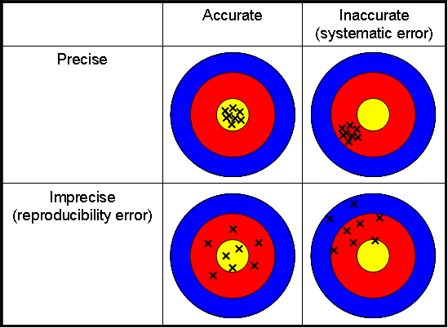
Accuracy vs. Precision

Slide 29

Precision vs. Reliability
Now you have seen that precision is internal reliability, note that reliability is best known as external reliability: whether repeated measurements between different experiments (or performed by different people/groups) agree with each other.

Slide 30
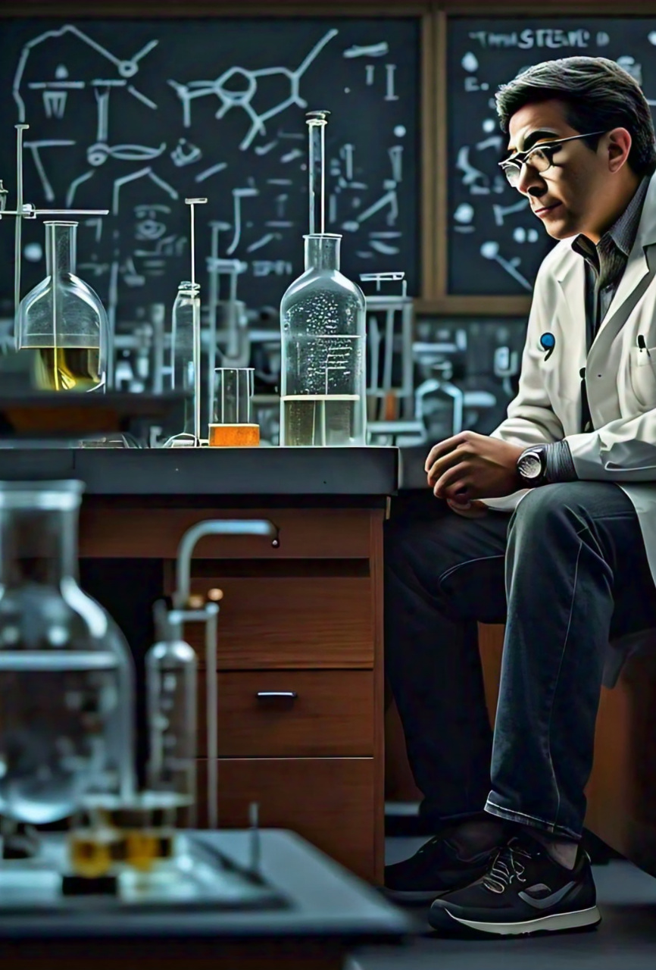
Accuracy with Uncertainty
Scientists often know how confident they are in their measurements. It is important to communicate this confidence.
Would confidence best be communicated qualitatively or quantitatively?
A quantity is the best, so we like to communicate our confidence/uncertainty with numbers.

Slide 31
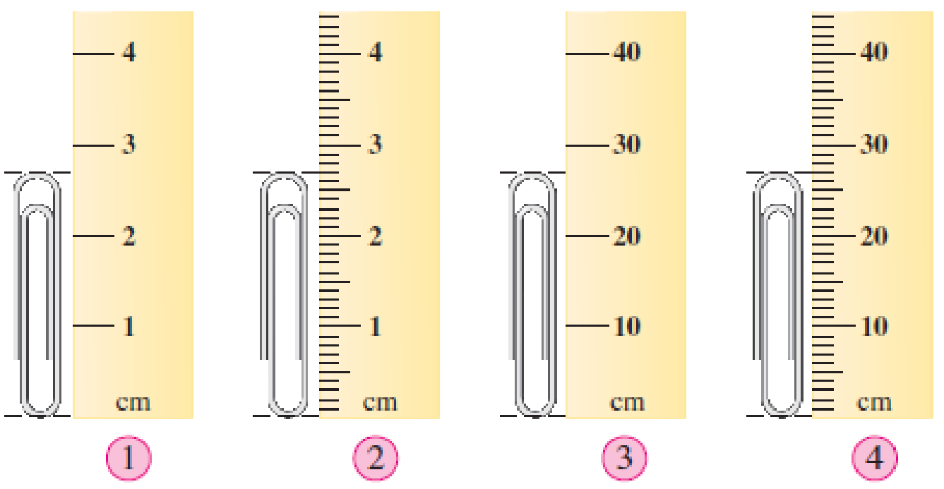
Uncertainty
The true value of a measurement cannot be accurately known.
Instead, it lies within a range of values and so all measurements are really estimations
Uncertainty is the best estimate of the magnitude of possible errors.
The uncertainty of a measurement depends on the:
smallest unit of the instrument (limit of resolution/reading)
precision of the instrument
precision of the method

Slide 32
Uncertainty
Measurement = best estimate ± uncertainty
e.g., a paperclip length = 3 ± 0.1 cm
or
e.g., the height of a person = 1.75 ± 0.05 m

Slide 33
Uncertainty in Analog Instruments
The absolute uncertainty is half of the smallest unit (a.k.a. the limit of resolution or the limit of reading)
We write the measurement as:
(best estimate ± ½ smallest increment) units
Example on next slide…

Slide 34
Uncertainty – Absolute Uncertainty
The best estimate of the measurement is 25.5 mm.
The limit of the resolution (smallest unit) is 1 mm
Therefore, absolute uncertainty is 0.5 mm (1/2 of 1 mm)
Written as: 25.5 ± 0.5 mm
What about relative uncertainty?

Slide 35
Uncertainty – Relative Uncertainty
If the accuracy with absolute uncertainty is 25.5 ± 0.5 mm, then we often like to calculate uncertainty as a percentage.
To do so, we divide the absolute uncertainty by the measurement, multiplied by 100, shown as a percentage.
e.g., 0.5 mm / 25.5 mm x 100(%) = 2%
Therefore, the relative uncertainty is now: 25.5 mm ± 2%

Slide 36
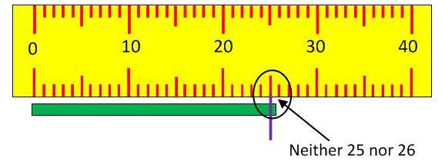
Uncertainty Example 1
Best estimate:
Absolute uncertainty:
Percentage uncertainty*:
Measurement:

Slide 37
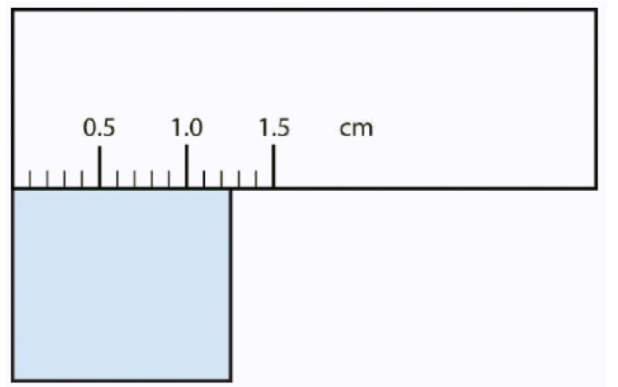
Uncertainty Example 2
Best estimate:
Absolute uncertainty:
Percentage uncertainty*:
Measurement:

Slide 38
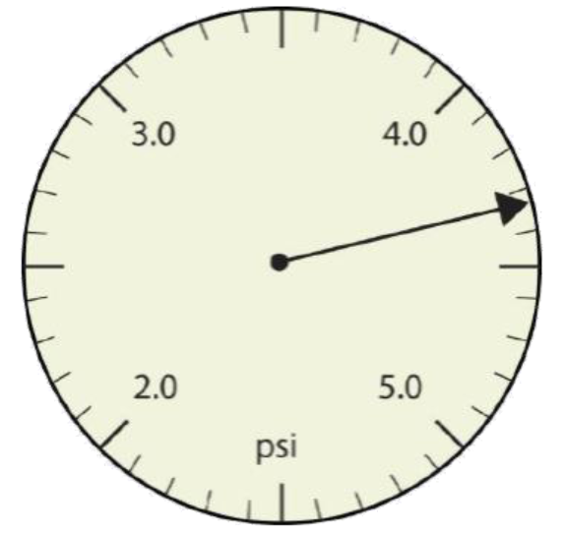
Uncertainty Example 3
Best estimate:
Absolute uncertainty:
Percentage uncertainty*:
Measurement:

Slide 39
Uncertainty for digital instruments
According to the DoE resource on evaluating data, the uncertainty of measurement is half of the highest significant figure.
For example, a digital voltmeter providing measurements to two decimal places.
For a reading of 12.55V, then the error of measurement is associated with the value of the number in the second decimal place (in this case, 0.05 V).
Since this number varies by 0.01 V (the reading lies between 12.55 V and 12.56 V), the uncertainty of measurement is half of this value, or 0.005 V.
Therefore, this measurement is reported as (12.55 ± 0.005) V.

Slide 40
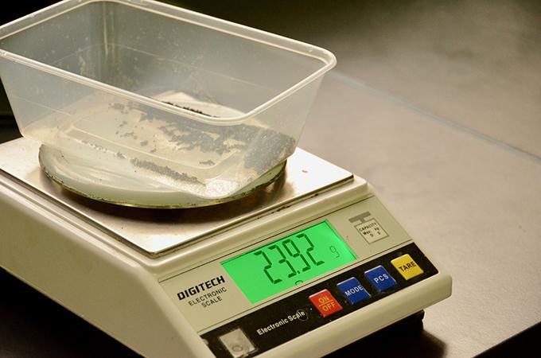
Uncertainty Example 4 – Digital
Best estimate:
Absolute uncertainty:
Percentage uncertainty*:
Measurement:

Slide 41
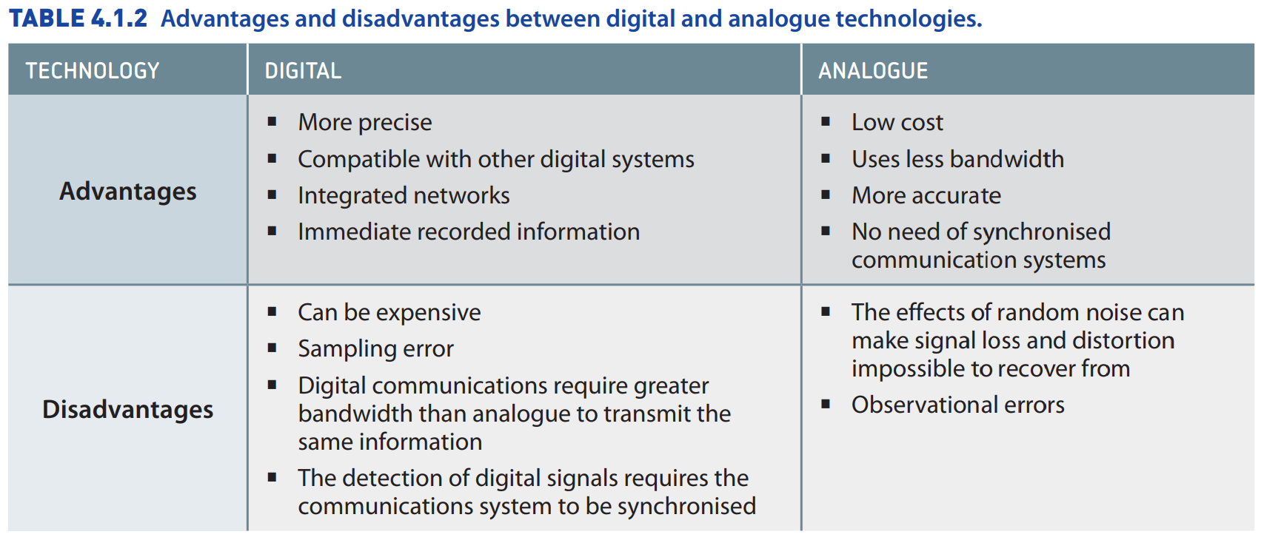
Comparing Analogue and Digital Technologies

Slide 42
Analogue vs Digital
Watch 6.1.4 – Under One Sky: Astronomy around the World
Read 6.1.4 – ABC News – Starlink
Identify examples of technologies and assess how they can limit or enhance the way we collect data and take measurements.
Evaluate whether digital or analogue technologies should be used in modern scientific investigations.

Slide 43
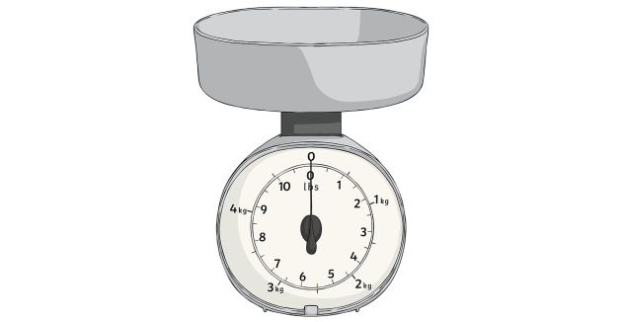
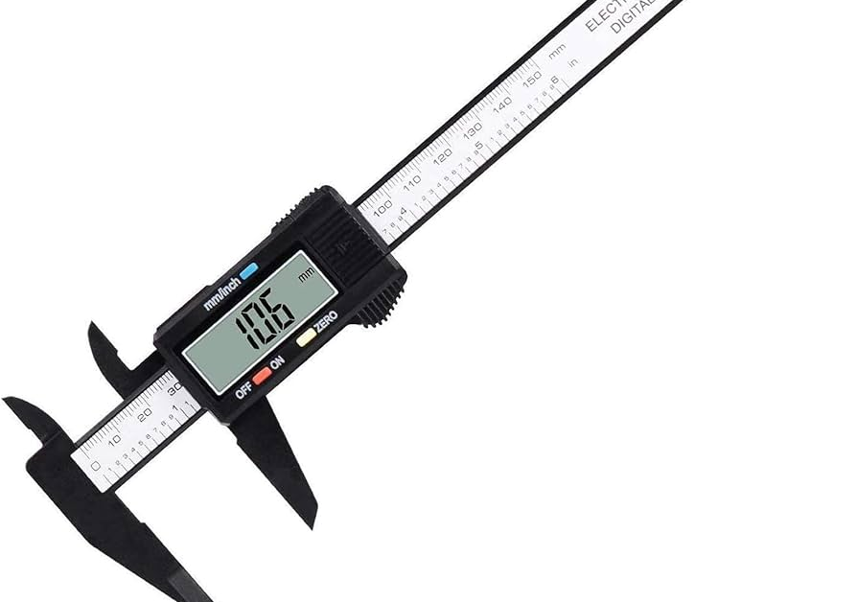
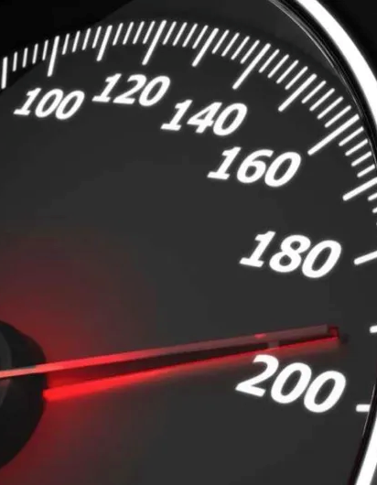
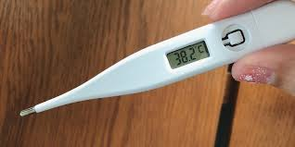
Compare These
Compare the following analogue and digital technologies. Use as many categories as you can. To start you off, consider:
Accuracy, precision, ease of use, cost, safety, potential errors
Thermometer
Weight scales
Ruler vs calliper
Speedometer

Slide 44
6.1.4
Assess the safety of technologies selected for the practical investigation by using chemical safety data and Work Health and Safety guidelines as appropriate

Slide 45
Risk Assessment
Material Safety Data Sheets (MSDS) are used to assess the safety of using a particular chemical.
Find an MSDS for hydrochloric acid (HCl).
Within the MSDS, locate suggested methods to control exposure / personal protective equipment (PPE)
Additionally, find first aid measures if exposure has occurred
Use the above to create a RIP (risk, injury, precaution/management) table for using hydrochloric acid

Slide 46
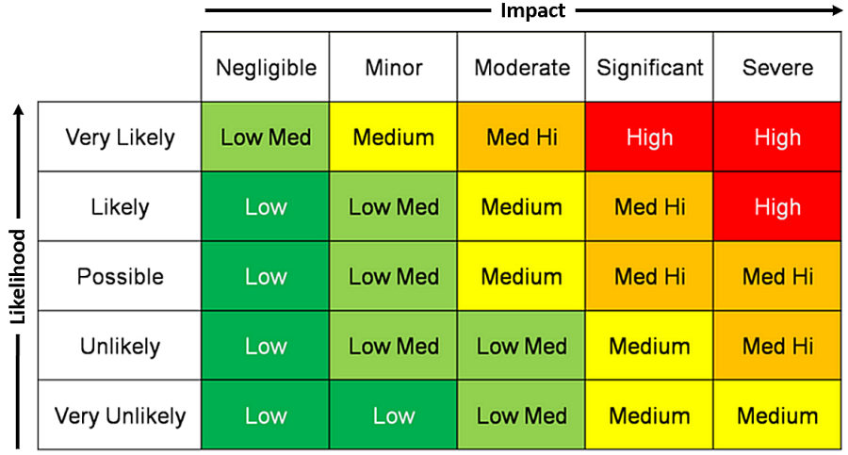
Risk Matrix

Slide 47
Risk Matrices
It is often handy to consult a risk matrix (plural: matrices) before conducting an experiment or using a particular chemical / instrument.
In doing so, you can assess your approach. For example, if you found there was a likely risk of something that would have a significant impact, you would likely conclude that the experiment is dangerous.
In this scenario, you would try to use a safer method, chemical or apparatus OR you would reassess the importance of the results obtained.

Slide 48
6.2 Syllabus
6.2: How have developments in technology led to advances in scientific theories and laws that, in turn, drive the need for further developments in technology?
6.2.1: using examples, assess the impact that developments in technologies have had on the accumulation of evidence for scientific theories, laws and models, including but not limited to:
computerised simulations and models of the Earth’s geological history
X-ray diffraction and the discovery of the structure of deoxyribonucleic acid (DNA)
technology to detect radioactivity and the development of atomic theory
the Hadron collider and discovery of the Higgs boson
6.2.2: using examples, assess the impact that developments in scientific theories, laws and models have had on the development of new technologies, including but not limited to:
the laws of refraction and reflection on the development of microscopes and telescopes
radioactivity and radioactive decay on the development of radiotherapy and nuclear bombs
the discovery of the structure of DNA and the development of biotechnologies to genetically modify organisms
Newton’s laws and the technology required to build buildings capable of withstanding earthquakes
6.2.3: investigate scientists’ increasing awareness of the value of Aboriginal and Torres Strait Islander Peoples’ knowledge and understanding of the medicinal and material uses of plants and, in partnership with communities, investigate the potential for ethical development of new drug treatments and synthetic chemicals through the bioharvesting of plants from Country and Place

Slide 49
6.2.1
Using examples, assess the impact that developments in technologies have had on the accumulation of evidence for scientific theories, laws and models, including but not limited to:
computerised simulations and models of the Earth’s geological history
X-ray diffraction and the discovery of the structure of deoxyribonucleic acid (DNA)
technology to detect radioactivity and the development of atomic theory
the Hadron collider and discovery of the Higgs boson

Slide 50
6.2.1.1
Assess the impact that developments in technologies have had on the accumulation of evidence for scientific theories, laws and models:
computerised simulations and models of the Earth’s geological history

Slide 51
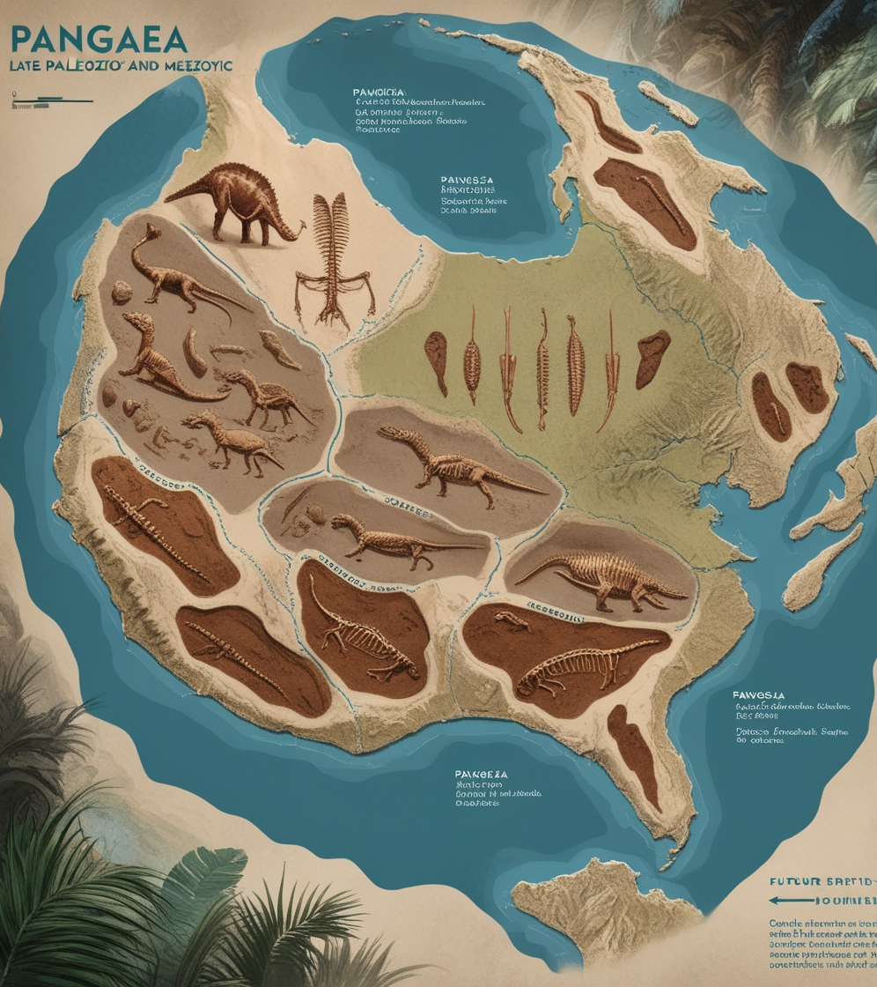
Models of Earth’s Geological History
Recall from Module 4: theory of plate tectonics; theory of continental drift.
What evidence do we have for the past in terms of Pangaea?
What evidence do we have for the future of continental drift or a new supercontinent?
Assess the impact that two named technologies have had on these developments.

Slide 52
6.2.1.2
Assess the impact that developments in technologies have had on the accumulation of evidence for scientific theories, laws and models:
X-ray diffraction and the discovery of the structure of deoxyribonucleic acid (DNA)

Slide 53
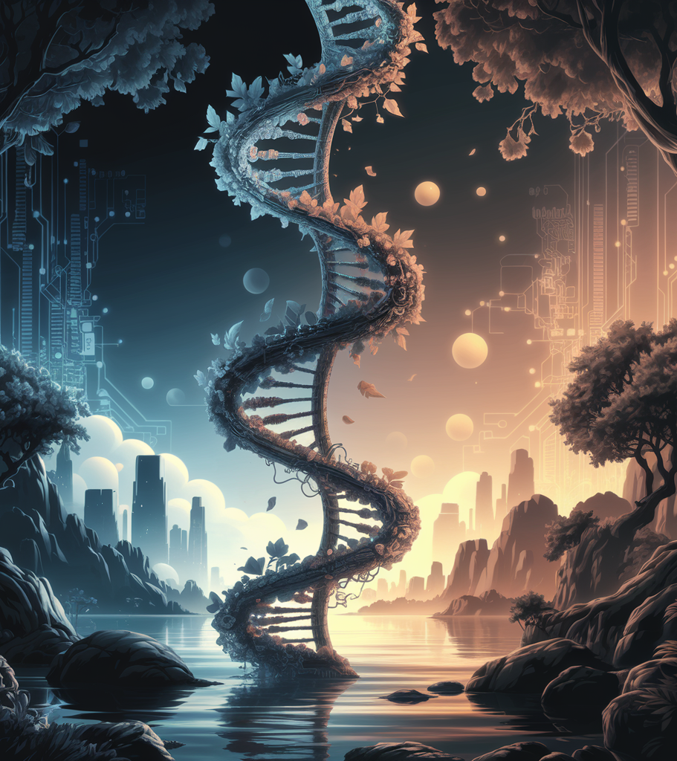
X-ray diffraction and DNA structure
Complete the following:
Describe the structure of DNA.
Identify the scientists who helped discover the structure of DNA.
State the technology that was vital in the confirmation of this discovery.
The answer here is X-ray diffraction.
Explain the importance of X-ray diffraction in the discovery of the structure of DNA.
Identify future technologies that have developed as a result of knowing the structure of DNA.

Slide 54
X-ray Diffraction and How it Works
Watch 6.2.1.2 - What is X-ray Diffraction (4 min)
Watch 6.2.1.2 - Rosalind Franklin - DNAs Unsung Hero (4 min)

Slide 55
Past Paper Question
Complete 6.2.1.2 - Xray diffraction and DNA past paper question

Slide 56
6.2.1.3
Assess the impact that developments in technologies have had on the accumulation of evidence for scientific theories, laws and models:
technology to detect radioactivity and the development of atomic theory

Slide 57
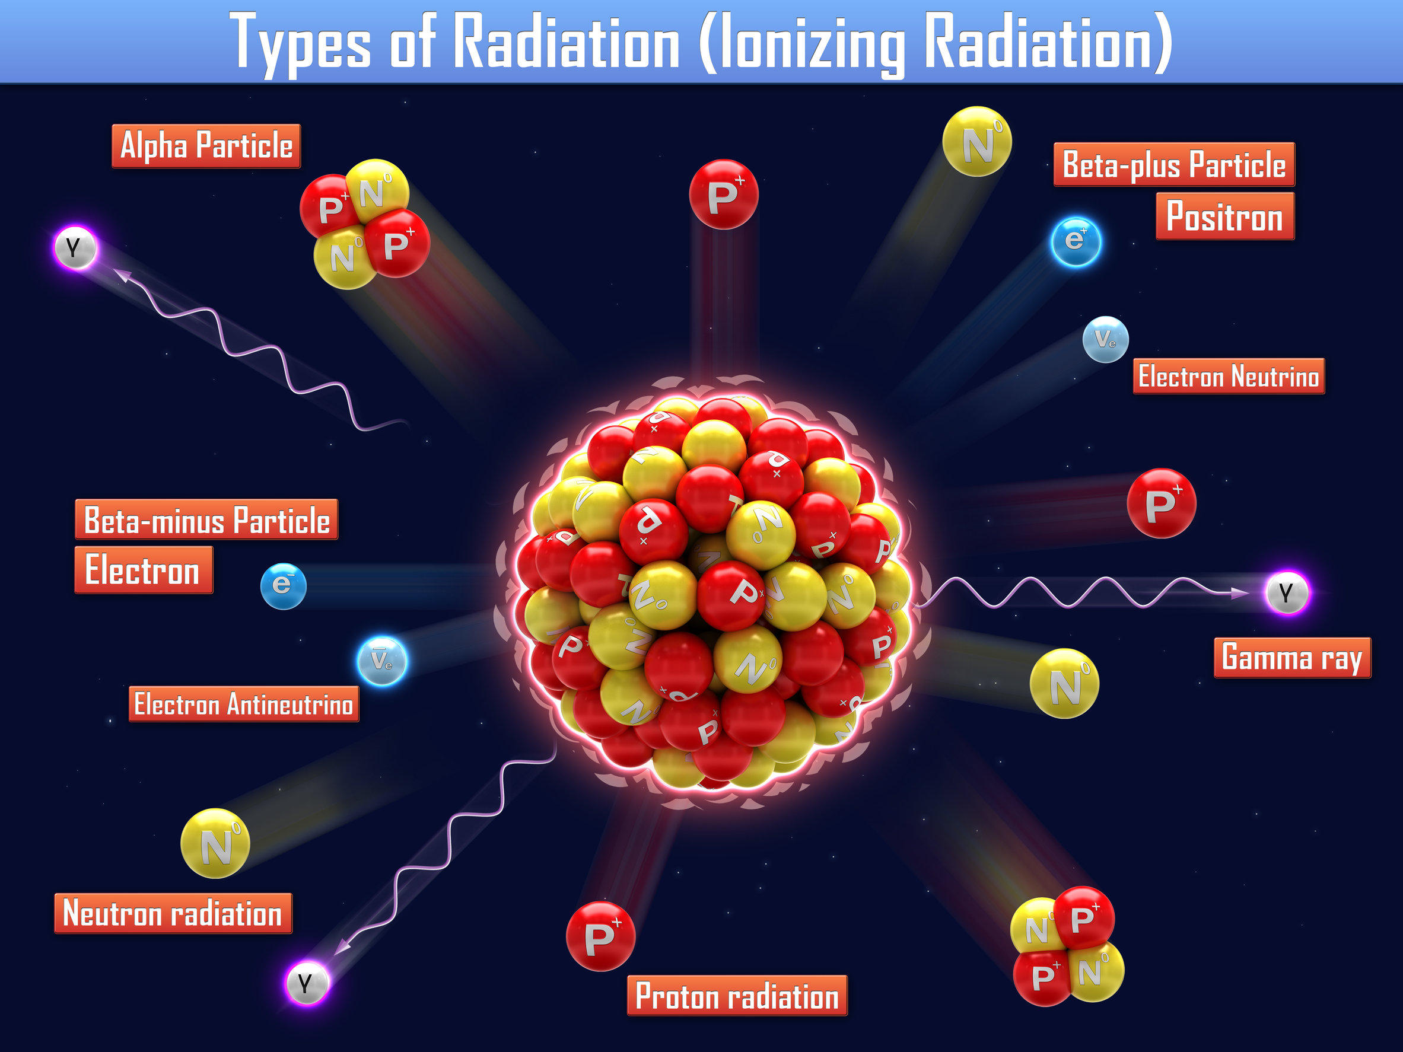
Radioactivity detection and atomic theory
Read 6.2.1.3 - Atomic Model & Radioactivity (pp 12-14)
Read 6.2.1.3 - The Discovery of Radioactivity
Identify the technology used to detect radioactivity.
Describe how the atomic theory/model developed further due to the discovery of radioactivity.

Slide 58
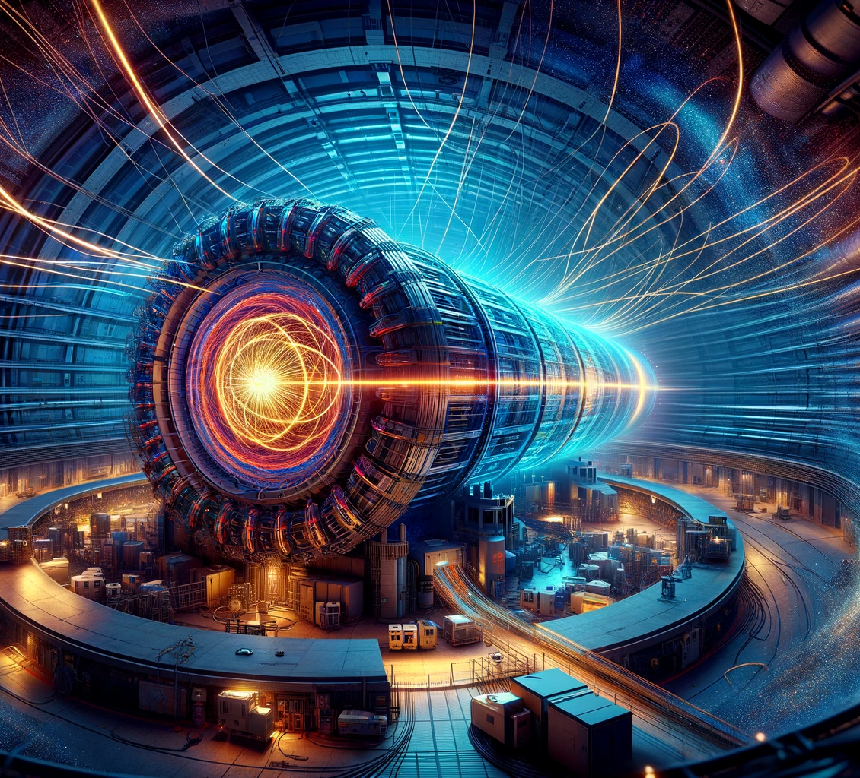
6.2.1.4
Assess the impact that developments in technologies have had on the accumulation of evidence for scientific theories, laws and models:
the Hadron collider and discovery of the Higgs boson

Slide 59
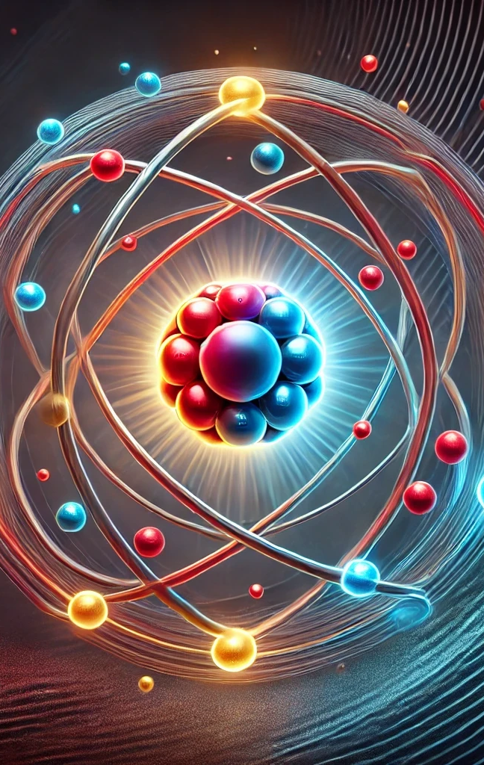
The Large Hadron Collider (LHC)
Watch 6.2.1.4 - What's Really Happening At CERN (17 min)
Watch 6.2.1.4 - The basics of the Higgs boson (7 min)
Describe how the LHC has impacted the development of the atomic model.

Slide 60
Past Paper Question
Complete 6.2.1.4 - The LHC and Higgs Boson Past Paper Question - 2022 Q30

Slide 61
6.2.2
Using examples, assess the impact that developments in scientific theories, laws and models have had on the development of new technologies, including but not limited to:
the laws of refraction and reflection on the development of microscopes and telescopes
radioactivity and radioactive decay on the development of radiotherapy and nuclear bombs
the discovery of the structure of DNA and the development of biotechnologies to genetically modify organisms
Newton’s laws and the technology required to build buildings capable of withstanding earthquakes

Slide 62
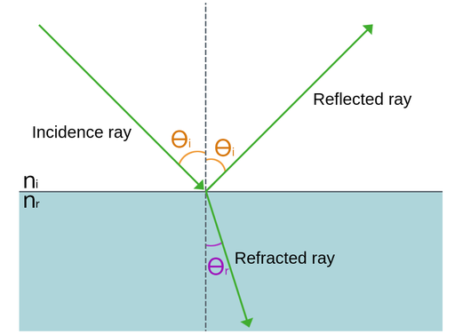
6.2.2.1 – Reflection vs Refraction

Slide 63
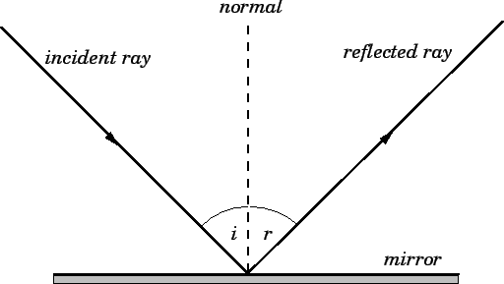
Law of Reflection
The law of reflection states that the incident ray, the reflected ray, and the normal to the surface of the mirror all lie in the same plane. Furthermore, the angle of reflection (r) is equal to the angle of incidence (i). Both angles are measured with respect to the normal to the mirror.

Slide 64
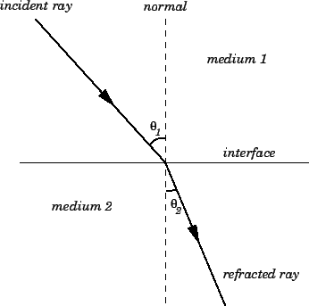
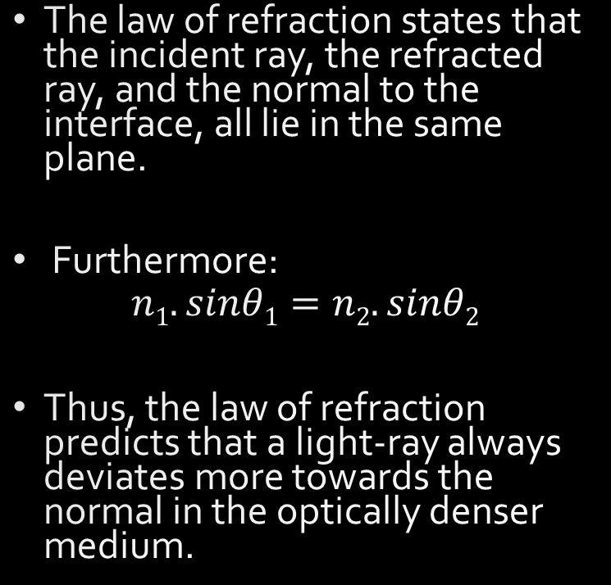
Law of Refraction
The law of refraction states that the incident ray, the refracted ray, and the normal to the interface, all lie in the same plane.
Furthermore:
$$n1.sinθ1=n2.sinθ2$$
Thus, the law of refraction predicts that a light-ray always deviates more towards the normal in the optically denser medium.

Slide 65
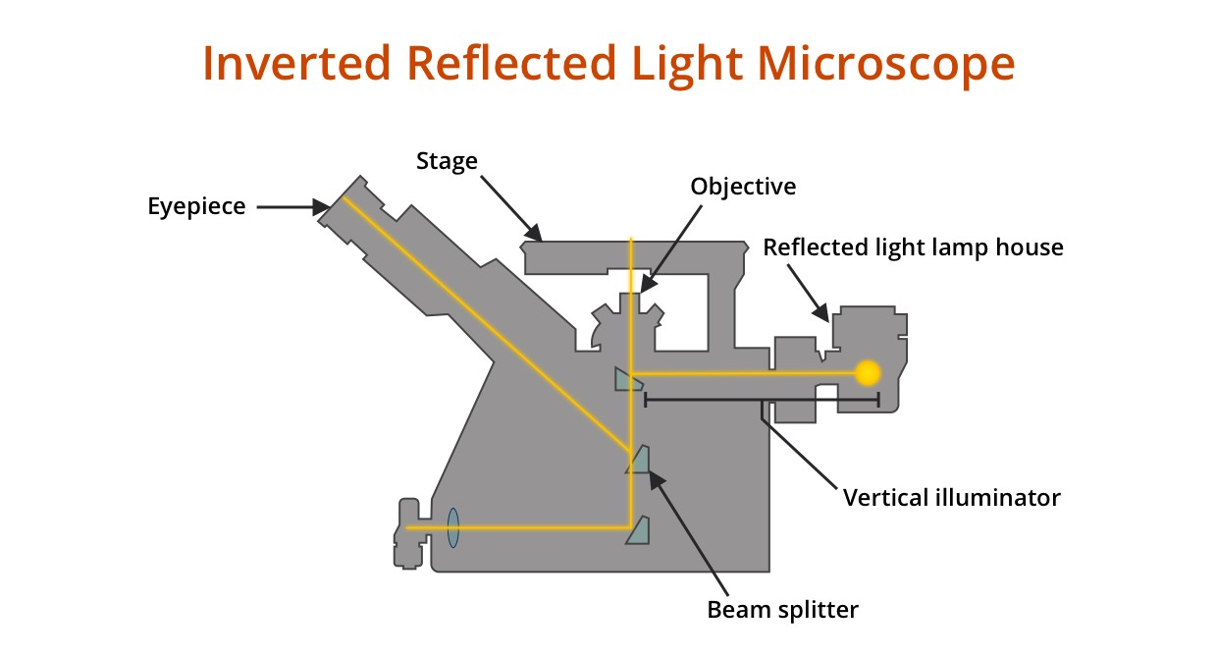
Reflection & Microscope

Slide 66
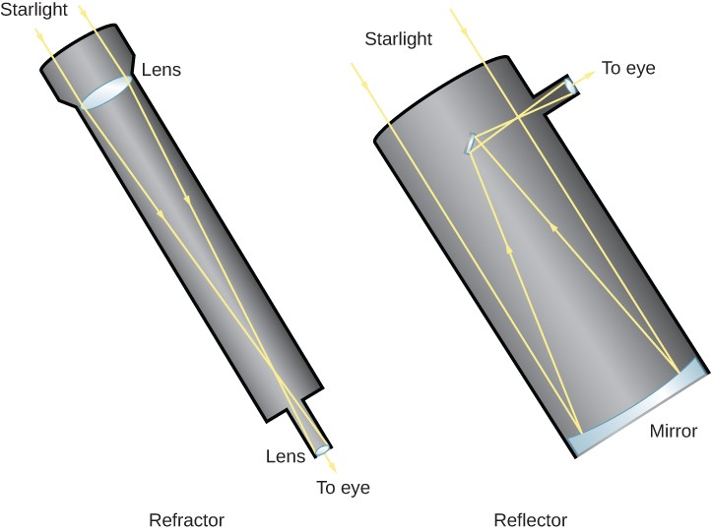
Reflection & Telescope

Slide 67
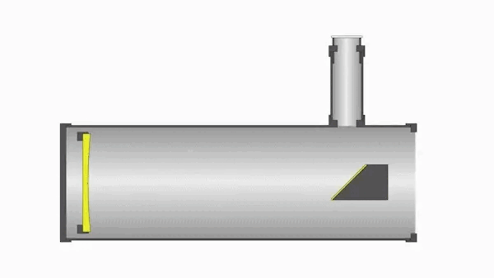
Reflection Telescopes

Slide 68
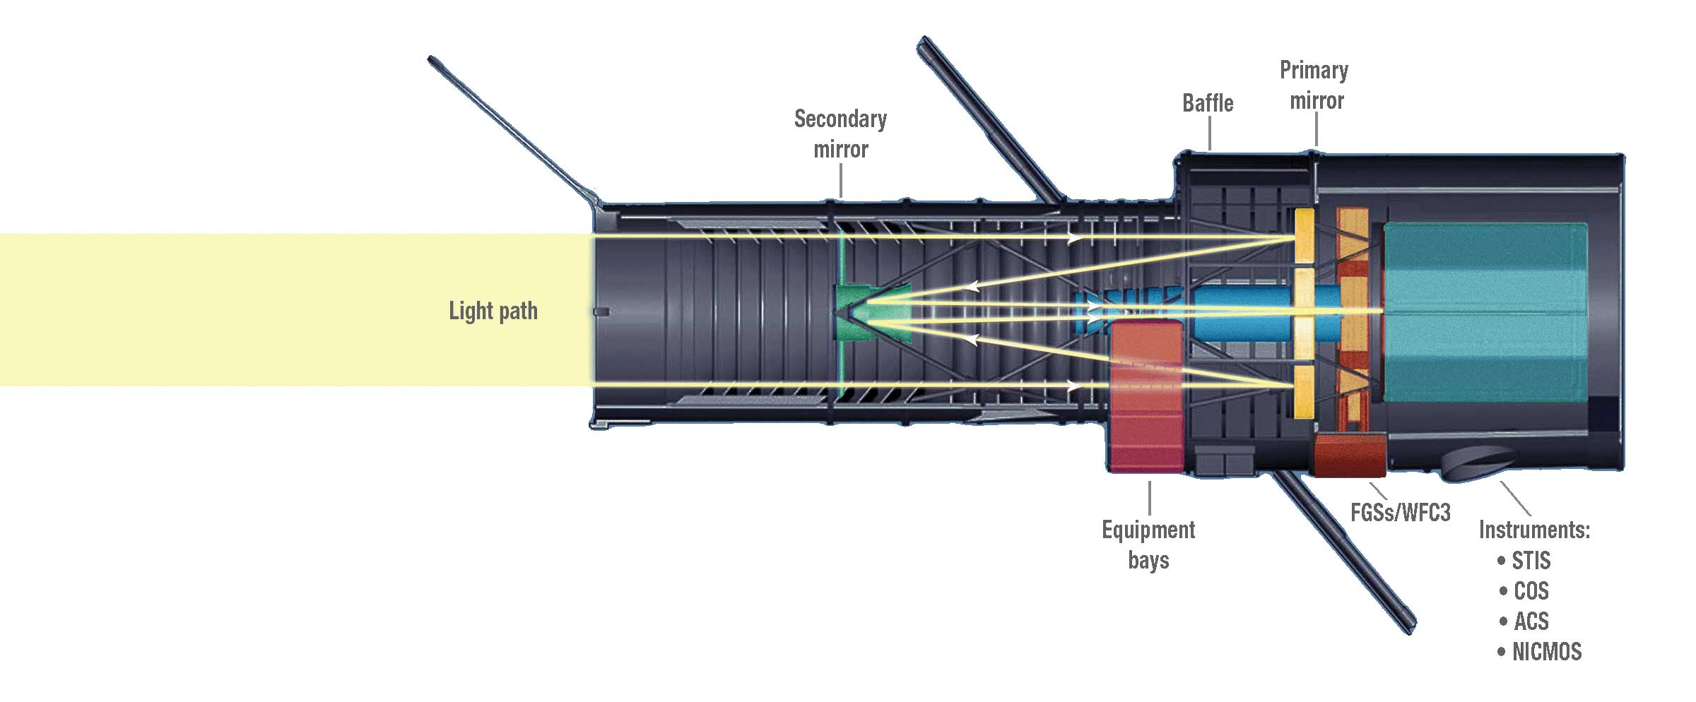
Reflection & Hubble Telescope

Slide 69
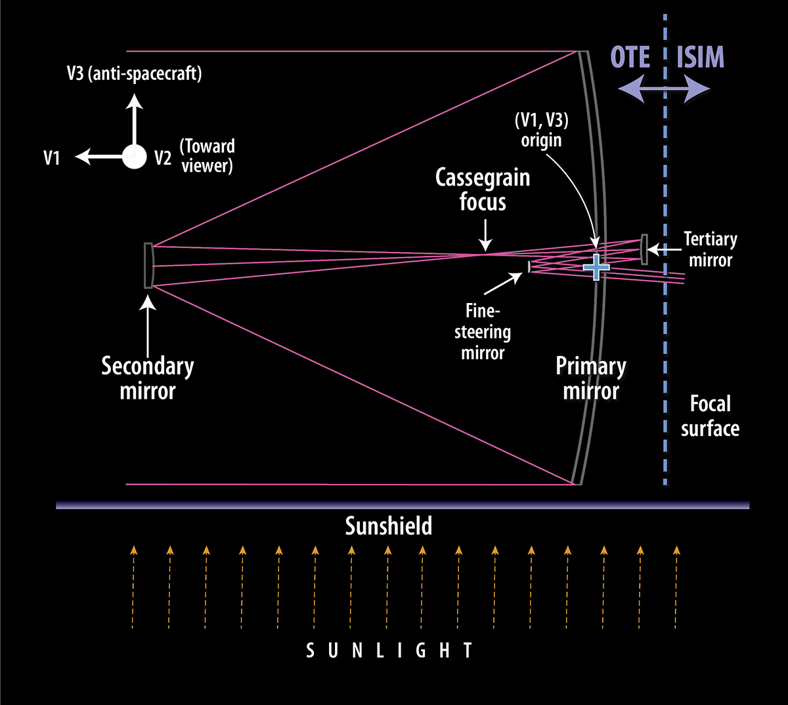
Reflection & JWST
JWST is similar to Hubble.
However, Hubble uses a 2.4 m primary mirror and JWST uses a 6.5 m primary mirror.
Light collecting areas:
Hubble: 4.52 m²
JWST: 33.18 m²

Slide 70
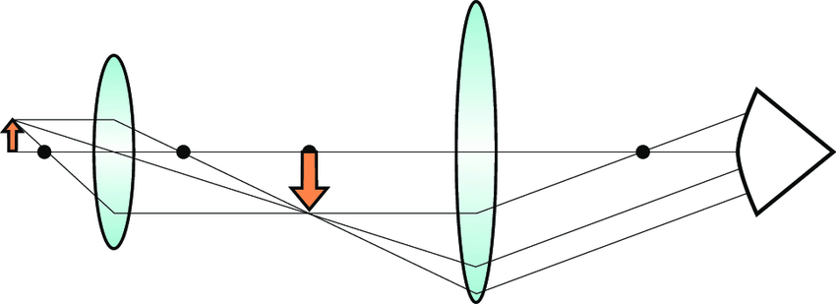
Refraction & Microscopes
A small image (left) can have light from it moved through increasing sizes of convex lenses and the image created appears larger.

Slide 71
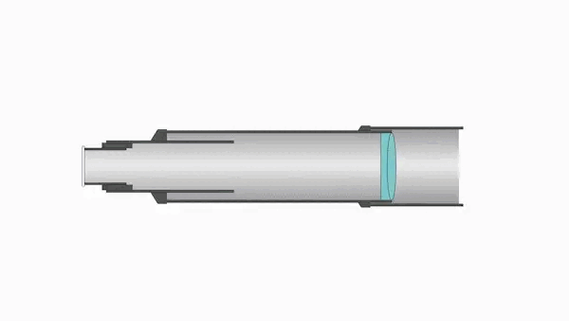
Refraction & Telescopes
The length and size of the lens of a refractor, combined with the fact that large lenses can be difficult and expensive for glassmakers to manufacture at high quality, means that larger refractors can get rather expensive.
For this reason, most refractors tend to be smaller-aperture models.

Slide 72
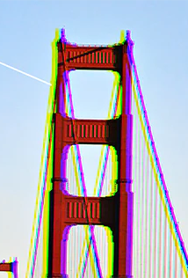
Colour Abberation
One drawback of refractors is chromatic aberration, which is colour fringing caused by the fact that different wavelengths of light are refracted at different angles by the same lens.
Specifically, a wave of light contains many different wavelengths. When these enter the lens, they split from each other and arrive at slightly different angles. To the observer, the image will contain distinct coloration at the edges.

Slide 73
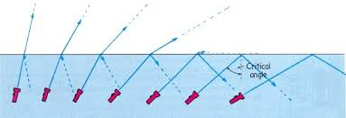
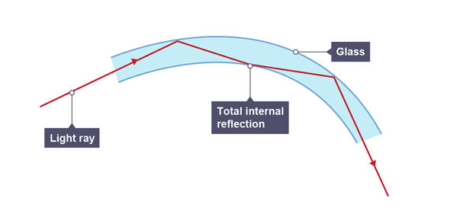
Bonus: Total Internal Reflection

Slide 74
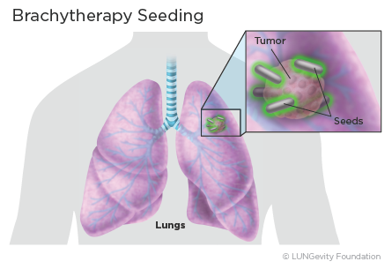

6.2.2.1 – Development of Radiotherapy
Nucleus Medical Media (2012): Cancer Treatment: IMRT (Radiation Therapy)
Watch 6.2.2.2 – Cancer Treatment - IMRT (Radiation Therapy)
Nucleus Medical Media (2014): Cancer Treatment: Brachytherapy Watch 6.2.2.2 – Cancer Treatment - Brachytherapy

Slide 75

6.2.2.2 – Nuclear Bomb Chemistry
Knowledge of radioactivity also harmed humanity.
Uranium-235 can be used to continue a chain reaction of neutron release and energy generation.
If done in a particular way, this is a nuclear bomb.
Watch 6.2.2.2 - How Nuclear Fission Works

Slide 76

6.2.2.3 – GMOs & Using Plasmids
A plasmid is a ring-shaped (circular) piece of DNA found in bacteria, fungi, and even some plants.
Plasmids float freely in the cell and are independent from the much larger chromosomal DNA
Plasmids autonomously replicate themselves
Plasmids carry genes to help them in specific situations, e.g., antibiotic resistance gene
Plasmids can be modified to express proteins of interest (DNA is the code for making proteins)

Slide 77

Producing GM Insulin
Plasmids can be modified to include DNA that code for proteins of interest to humans.
e.g., human insulin can be created by bacteria instead of extracted from a pig pancreas.

Slide 78
Producing GM Insulin
The bacteria produce the insulin protein using the code on the plasmid.
The insulin can then be taken from the broth the bacteria are living in.
The insulin is then purified, and the bacteria continue making more insulin.

Slide 79

CRISPR
Watch 6.2.2.3 - How CRISPR lets you edit DNA

Slide 80

6.2.2.4
Newton’s laws and the technology required to build buildings capable of withstanding earthquakes

Slide 81


Derek’s Three Incorrect Laws of Motion
Watch 6.2.2.4 - Three Incorrect Laws of Motion
What evidence does Derek use for each of his laws?
For each of his incorrect laws, why is Derek wrong?

Slide 82

What happens in an earthquake?
12 January 2010 – Haiti, Magnitude 7.0
Death Toll: Various estimates 100,000 – 316,000
Tsunami: localised
Haiti disaster: UN headquarters collapse
Watch 6.2.2.4 - Haiti disaster - UN headquarters collapse
11 March 2011 – Japan (Tsunami), Magnitude 9.1
Death toll: 15,899 (+ 2,529 missing) (mainly due to Tsunami)
Tsunami: 40.5 m
Fukushima nuclear disaster
This energy in this earthquake is more than 1400 times that of Haiti, yet compare the building damage
Dancing Buildings in Japan during Earthquake
Watch 6.2.2.4 - Dancing Buildings in Japan during Earthquake

Slide 83
Why do some buildings fall but others don’t?
Why do buildings fall in earthquakes?
Watch 6.2.2.4 - Why do buildings fall in earthquakes (5 min)
What to look for:
What do engineers use to understand the cause of building collapse and design ‘earthquake-proof’ buildings?
Why does the same earthquake vibration (wave) affect buildings differently?
Which properties are engineers most concerned with when designing buildings?
What are two common approaches for designing ‘earthquake-proof’ buildings? How do they work?

Slide 84
Current and future technology
The Future of Earthquake-Proof Buildings (SciShow, 2019)
Watch 6.2.2.4 - Can We Make Buildings Truly Earthquake-Proof
10 Technologies that help buildings resist earthquakes
Read 6.2.2.4 - 10 Technologies That Help Buildings Resist Earthquakes
Describe how each design approach relates to Newton’s Laws:
First Law: An object will keep doing what it is currently doing unless acted upon by an unbalanced force
Second Law: Force = mass x acceleration
Third Law: For every action force, there is an equal and opposite reaction force

Slide 85

6.2.3
Investigate scientists’ increasing awareness of the value of Aboriginal and Torres Strait Islander Peoples’ knowledge and understanding of the medicinal and material uses of plants and, in partnership with communities, investigate the potential for ethical development of new drug treatments and synthetic chemicals through the bioharvesting of plants from Country and Place

Slide 86

Bio harvesting from country and place
Aboriginal and Torres Strait Islander (ATSI) communities have been harvesting materials from nature and making useful products for tens of thousands of years. The techniques and knowledge has been passed down through oral and hands on means from one generation to the next. Many plants and materials harvested have been used for medicinal purposes, food and technologies.
The act of collecting living organisms from the environment be used for food, medicinal purposes and technologies is called bio harvesting.

Slide 87

Bio harvesting
Scientists and now recognising the inherit value of all this accumulated knowledge and the challenge has emerged to find useful product from these materials by developing positive communication between themselves and the ATSI communities.
Other factors to consider would be potential environmental impacts, intellectual and property, ethical concerns and appropriate consultation.

Slide 88

Bio harvesting examples
Using spinifex resin to make a bioplastic – 6.2.3 – Australian Aboriginal use of Spinifex resin technology
Plants uses and medicines near Woorabinda with Steve Kemp – 6.2.3 – Plants uses and medicines near Woorabinda
Refer to 6.2.3 – Ethical guidelines for research with Aboriginal and Torres Strait Islander peoples
Refer to 6.2.3 - Keeping-research-on-track

